Slide 1
Hi, I'm Saurabh

Slide 2
I worked as a Web developer in my training period

Slide 3
We are going to talk about
Web Sockets

Slide 4
WebSocket makes a two-way interactive communication session.

Slide 5
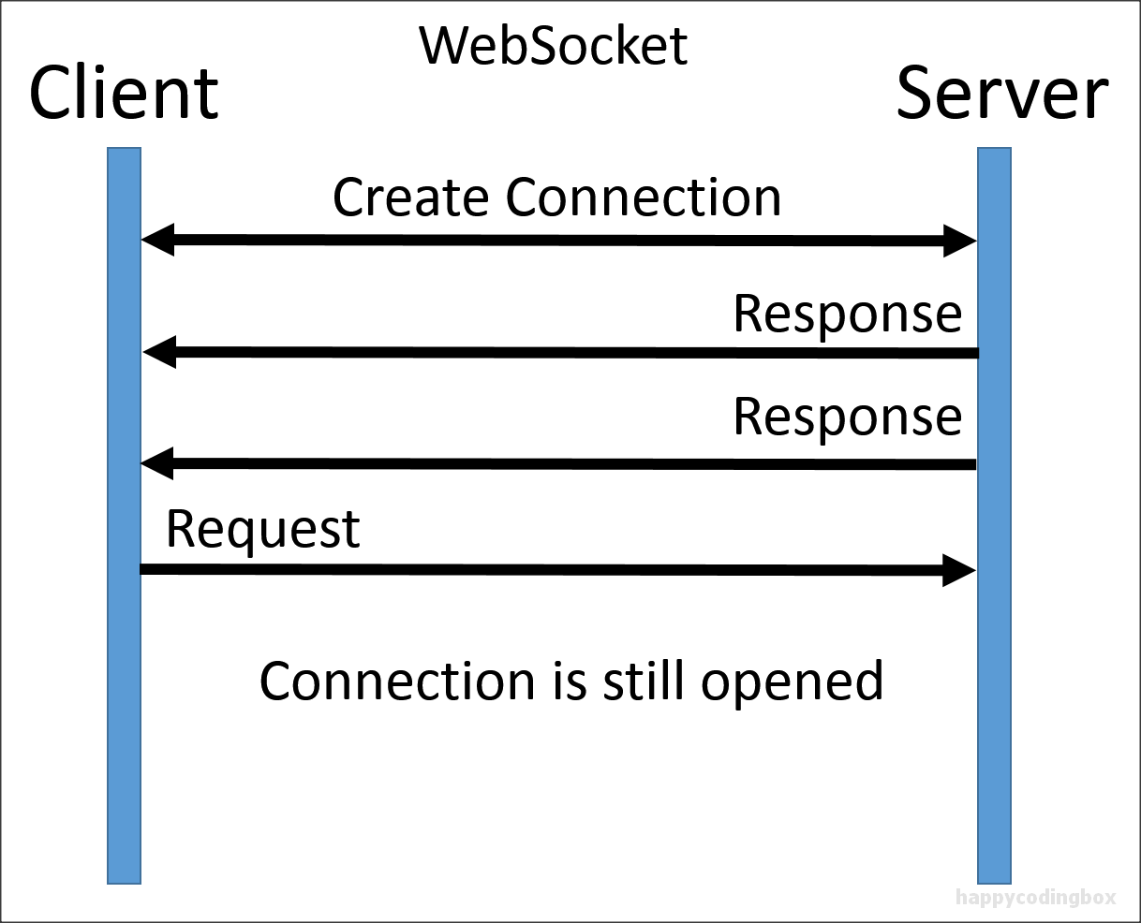

Slide 6
Why Web Sockets
Full-duplex

Slide 7
Why Web Sockets
Full-duplex
Backward compatible

Slide 8
Why Web Sockets
Full-duplex
Backward compatible
Lower latency interaction

Slide 9
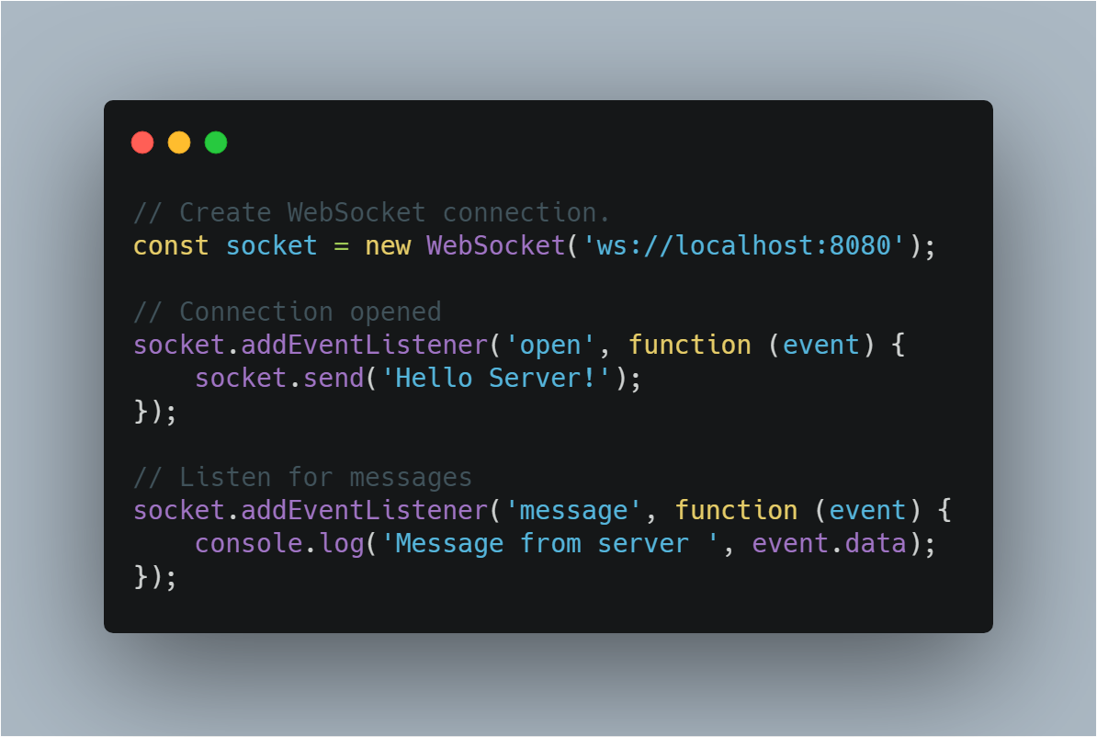

Slide 10
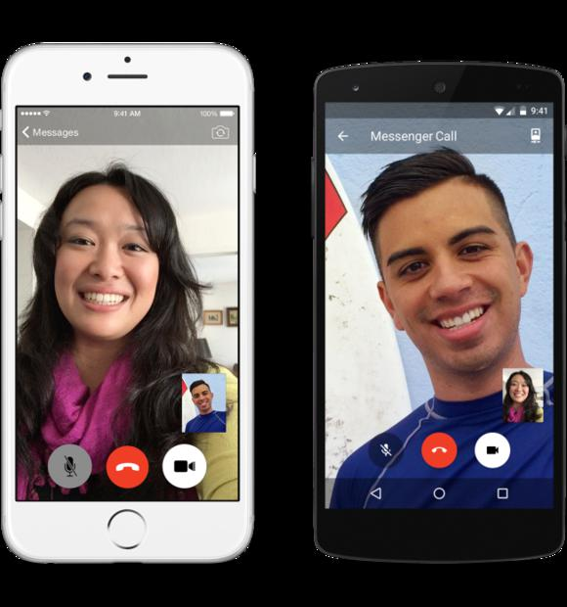

Slide 11
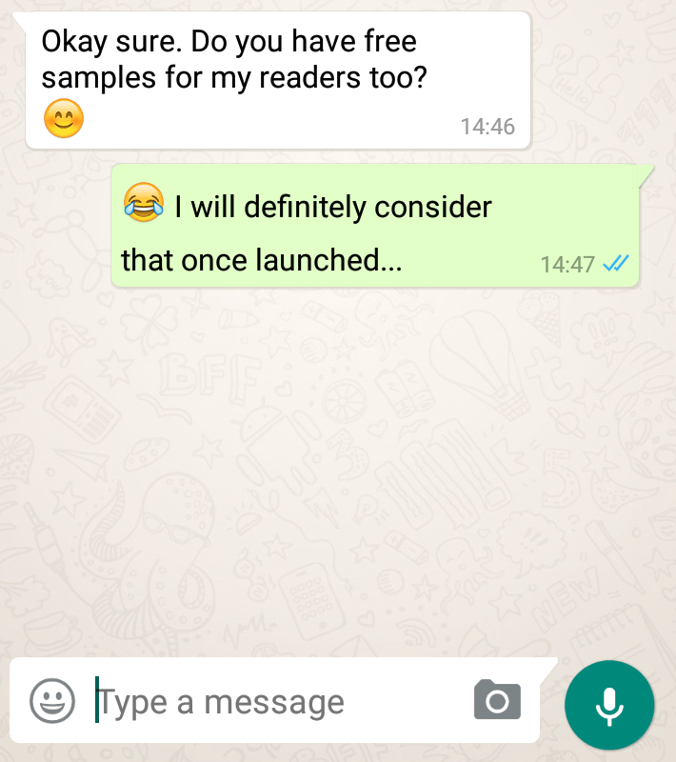

Slide 12
Let's talk about my project

Slide 13
It's a real-time text editor

Slide 14
Made with
Node.js
Javascript
HTML & CSS

Slide 15
Open sourced at: https://github.com/itsjzt/real-time-editor

Slide 16
Currently No Database

Slide 17
Deployed at: https://college--project.herokuapp.com/

Slide 18
Thank you

